Slide 1




GROUP PROJECT
Team 4
Accounts Payable operations and Reporting in Oracle ERP
Supervisor :- MR . Ehab Abdelgilil

Slide 2


Team Members
Leader :- Ahmed Mamdouh
Alaa Ibrahim Hassan
Fatma Alzhraa Adel Fawzey
Youssef Mohamed Ahmed
Mina Albeer Murad
1. Create and Manage Supplier Invoices.
2.Create Invoice Matching (PO Matching).
3.Done Invoice Adjustments and Holds.
4. Create Supplier inquiry.
5. Process Supplier Payments.
6.Create Payment Batches.
7. Handle Prepayments and Advances.
8. Create Void Payments and Refunds.
1. I carefully selected and edited high-quality photos and screenshots
2. I ensured that the fonts, colors, and shapes are consistent and enhance readability
3. I paid close attention to detail to create a visually cohesive presentation
AP Period-End Close.
Generate Financial Reports.
Presentation.
1- Prepare the documentation for the project.
2- Presentation.
Mahetab Ellsayed Abdelshafiy
Presentation

Slide 3


0
Project Goal :-
To optimize the Accounts Payable process within
Oracle EBS R12 by streamlining invoice management, improving payment accuracy, and enhancing financial reporting capabilities, resulting in reduced operational costs, improved cash flow, and enhanced
compliance with financial regulations.

Slide 4

Project Description:-
This project focuses on training users on how to manage accounts payable operations in Oracle
ERP. It covers tasks like creating and managing
vendor invoices, processing payments, handling prepayments and advances, and performing
period-end closing activities. The goal is to ensure efficient and accurate accounts payable processes..

Slide 5
Before the project
● Accounts payable processes before Oracle often involved manual, paper-based
systems that were prone to errors and inefficiencies.
here some manual methods :-
Receiving and Reviewing Invoices
Three-Way Matching
Coding and Approval
Voucher Creation
Check Preparation and Mailing
Filing and Recordkeeping
* Invoices were received from vendors in paper format.
* They were reviewed for accuracy, completeness, and authorization.
* Purchase orders (POs) were compared to invoices and receiving reports to ensure they matched in terms of quantity, price, and vendor.
* Invoices were coded to the appropriate general ledger (GL) accounts. * They were routed for approval based on predetermined thresholds
* A voucher was created for each approved invoice, summarizing the details and assigning a unique number.
* Checks were cut and mailed to vendors based on the voucher information
* Invoices, vouchers, and checks were filed for future reference and audit purposes.

Slide 6
PROCESS
The process for resolving this problem involves these key stages:-
1- Vendor invoices and billing.
2- Payment processing and cash management.
3- Period-End closing and reporting.
Stage one :- Vendor invoices and billing
1- First of all we should access the Invoicing Module By Logging in to Oracle EBS R12 and navigate to the Invoicing
module.
This is typically found under the "Payables" menu. And then we Choose the "Create Invoice"
option.
Stage one :- Vendor invoices and billing
First :- create and manage supplier invoices

Slide 7

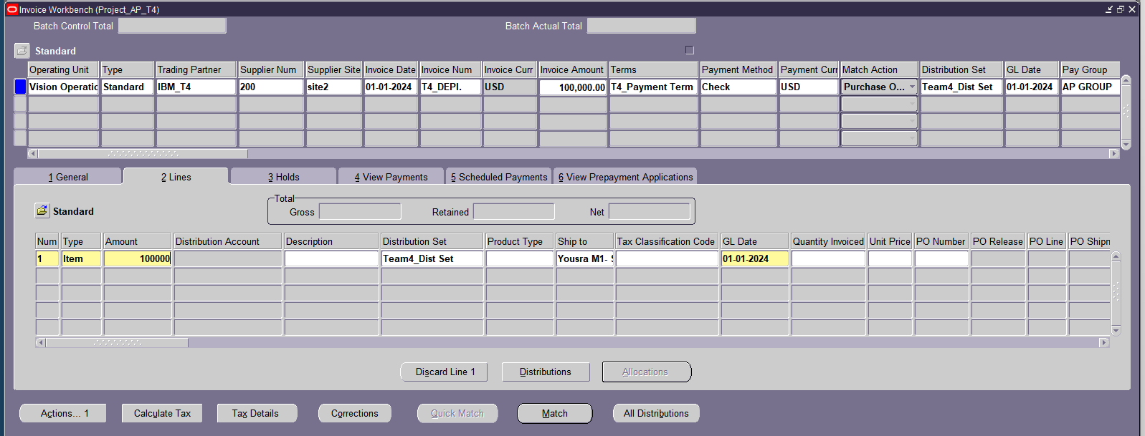
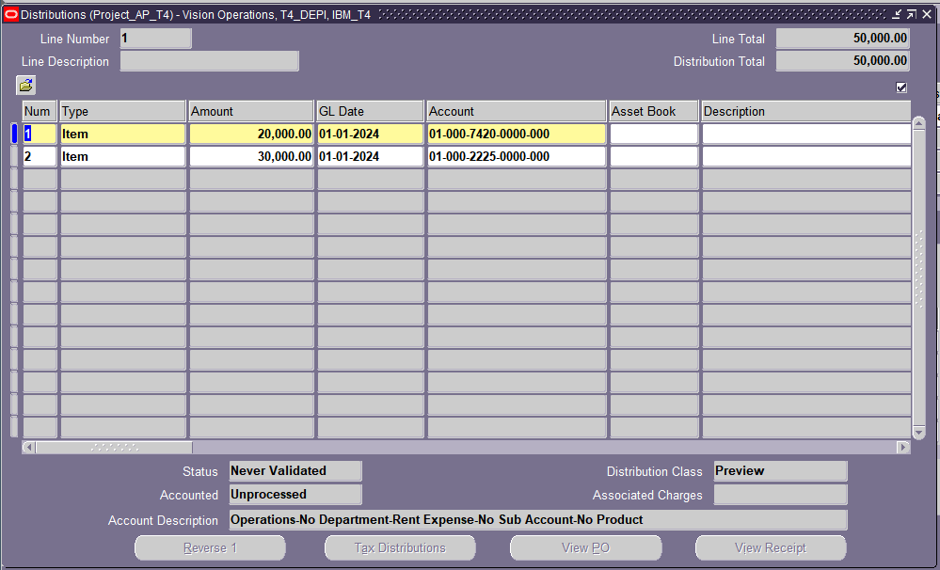
2. Enter Invoice Header Information :-
* Invoice Date: Enter the date of the invoice. ( 01-01-2024)
* Document Type: Choose the appropriate document type (Purchase Order)
* Currency: Specify the currency in which the invoice is issue. ( Dollar )
* Unit Price: Input the unit price for the item or service. ( 100,000)
.

Slide 8
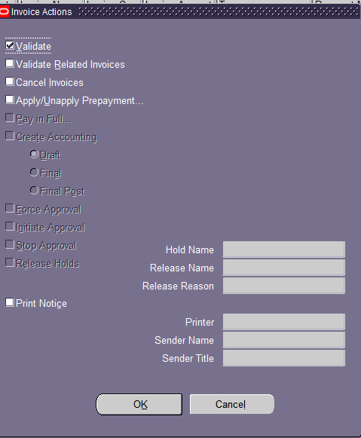
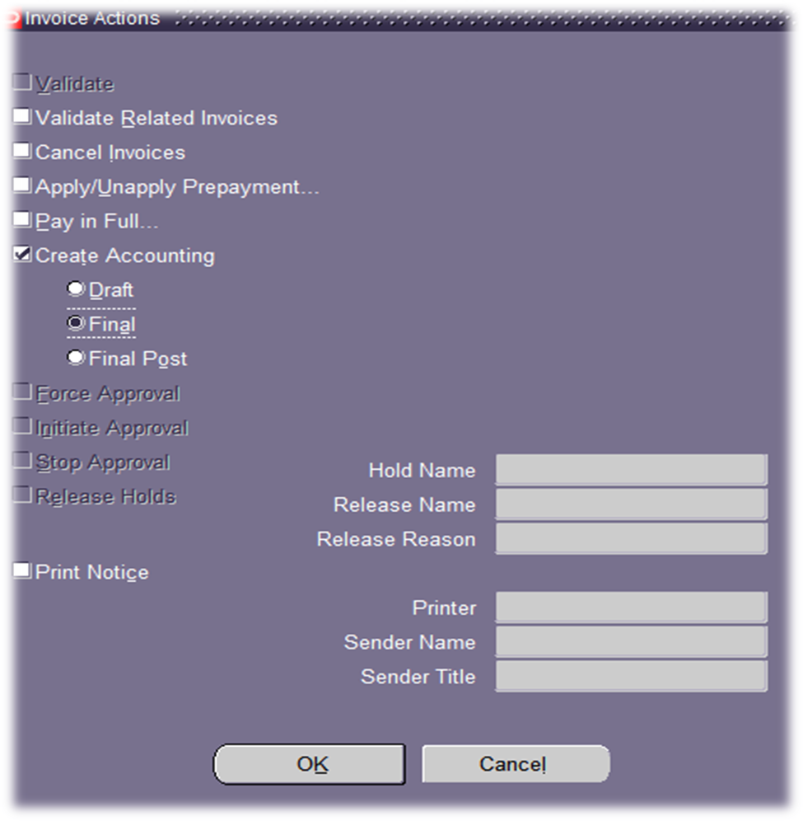
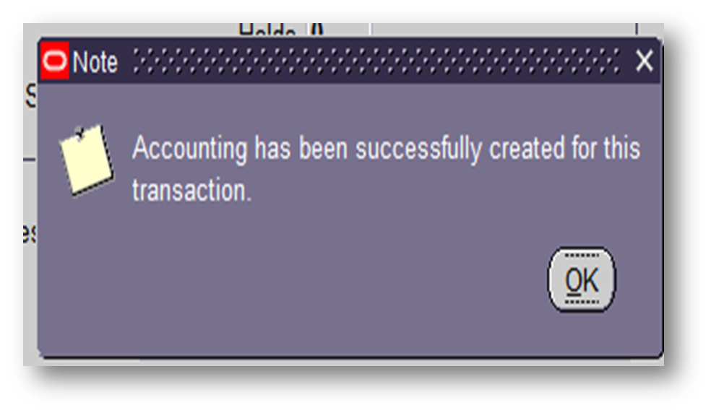
3- Validation and posting :-
*The system verifies that the invoice terms and conditions comply with the supplier's contract and the
company's policies and applies the relevant accounting rules to the invoice, such as accrual or cash basis
accounting and the invoice will be posting to the general ledger, creating corresponding journal.
.

Slide 9
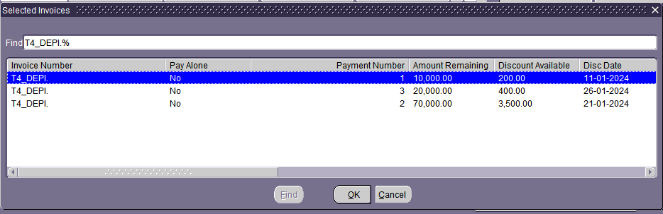
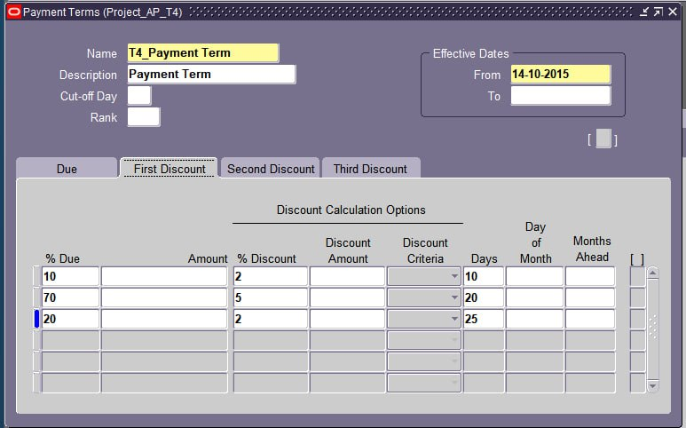
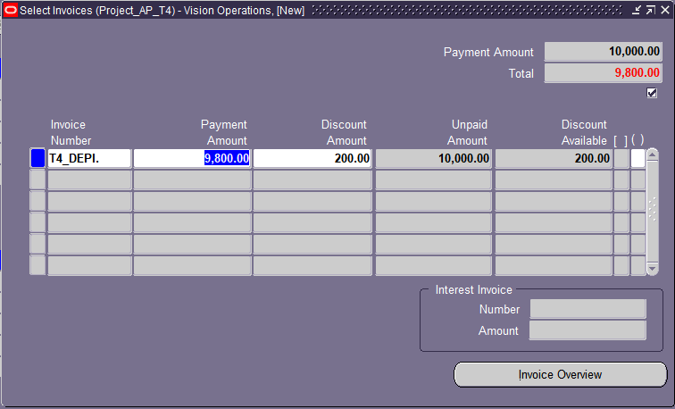
A. Discount
* Apply adjustments (discount):- based on the payment terms, a 2% discount will be applied if 10%
of the invoice value is paid in ten days.
* Then we will search for the invoice.
.
Second :- Invoice adjustment and holds:-

Slide 10
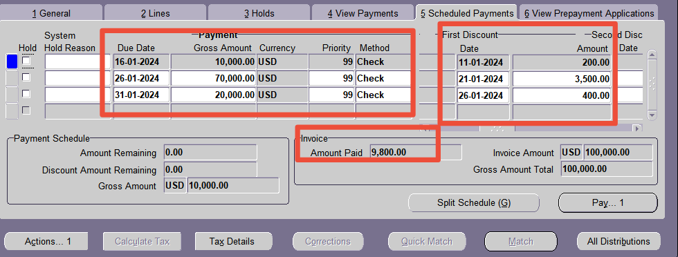
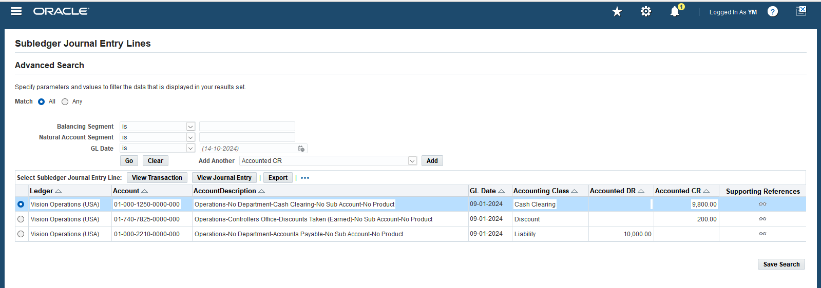
*The invoice will be posting
to the general ledger, creating
corresponding journal
.

Slide 11
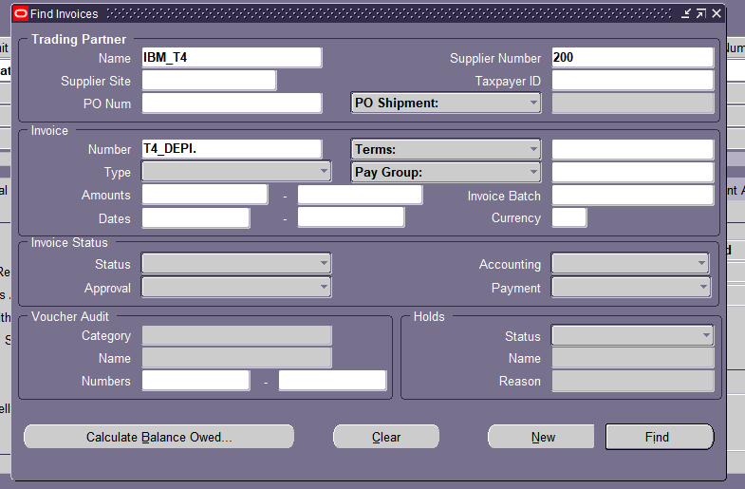
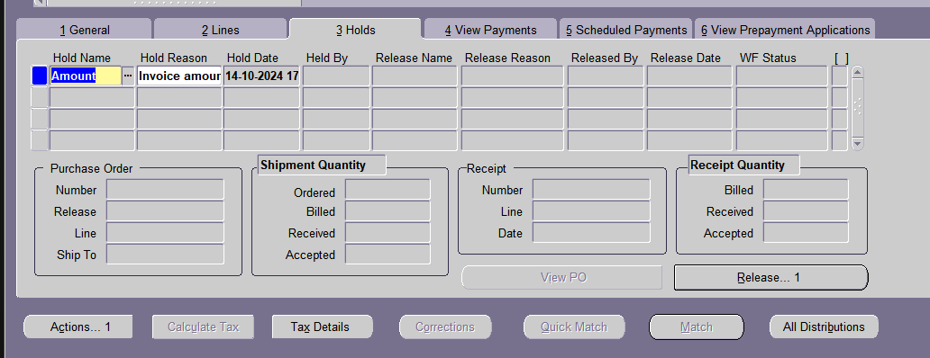
B. Hold and Release
- Steps to Hold an Invoice: * Navigate to the Invoice:
* Open the Payables responsibility.
* Go to the Invoices window.
* Search for the invoice you want to hold.
* Place the Hold:
* Click on the "Holds" tab.
* Click "OK" to apply the hold.

Slide 12
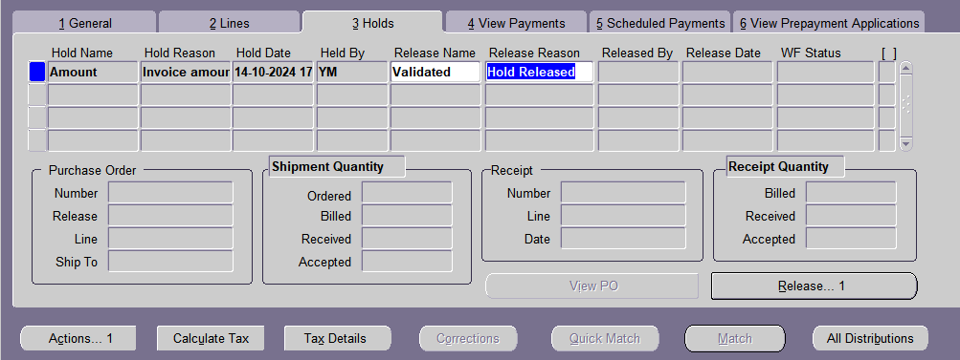
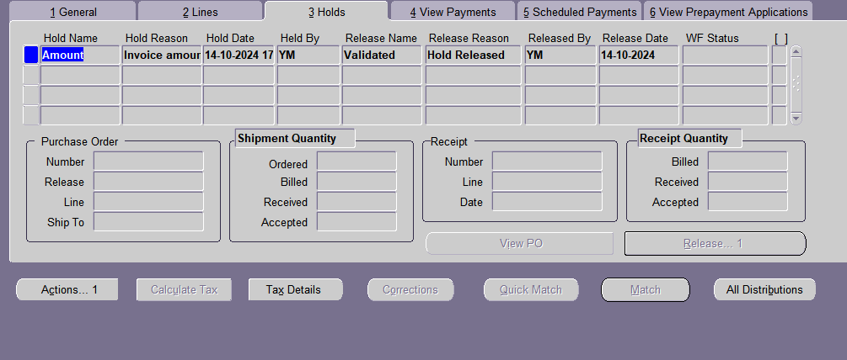
- Steps to Release an Invoice:
* Go to the Invoice Holds window.
* Find the invoice that has been placed on hold.
* Click on the "Release" button.
* Select the appropriate release reason from the list.
* Click "OK" to release the hold.
.

Slide 13
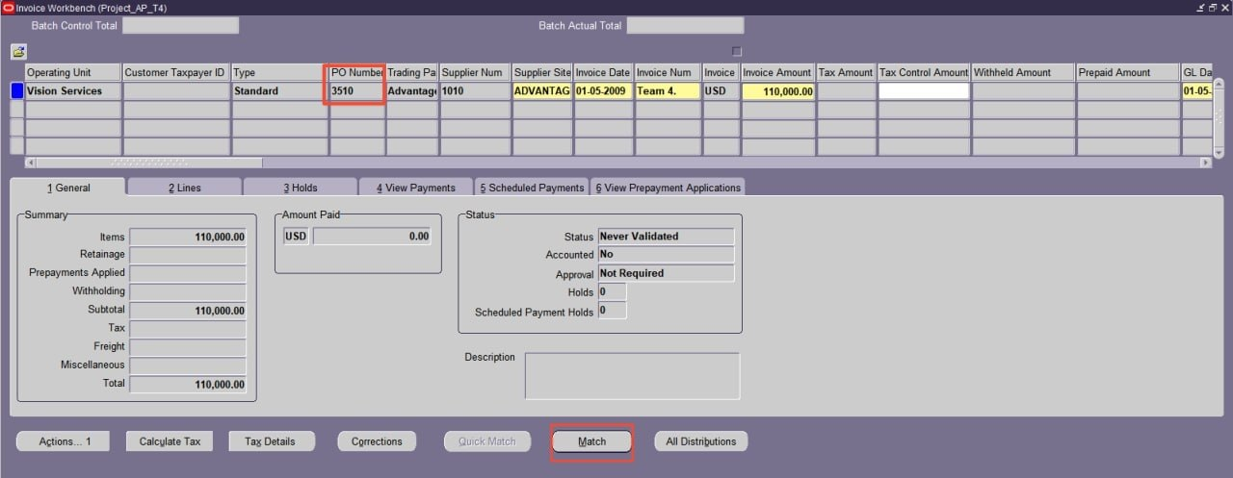
1- First of all , we should access the Invoicing Module By Logging in to Oracle EBS R12 and navigate to the Invoicing module. This is typically found under the "Payables" menu. And then we Choose the "Create Invoice” option
2- Enter Invoice Header Information:-
* Invoice Date: Enter the date of the invoice. (01-05-2009)
* Document Type: Choose the appropriate document type ( Purchase Order ).
* Currency: Specify the currency in which the invoice is issued.( Dollar )
* Unit Price: Input the unit price for the item or service. (110,000)
Third:- Matching Invoice

Slide 14
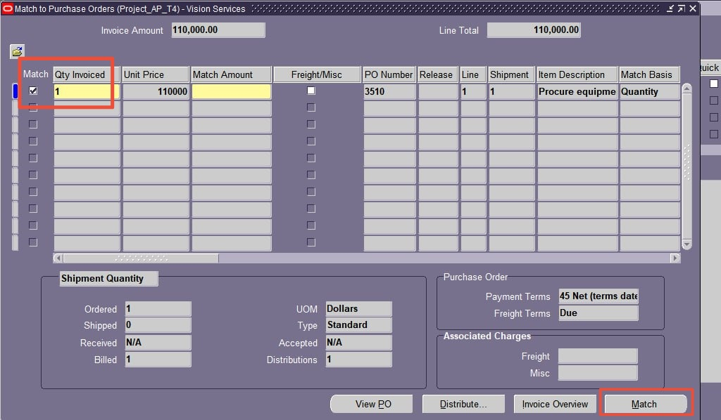
3. Attach Supporting Documents :-
* choose a purchase order and match the invoice with it .

Slide 15
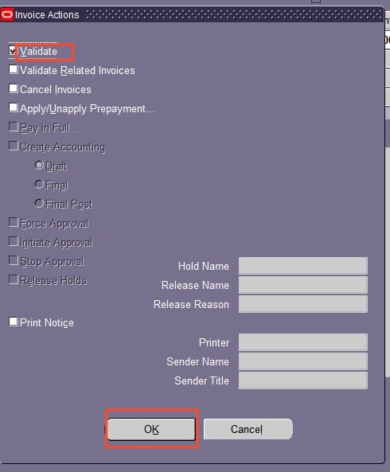
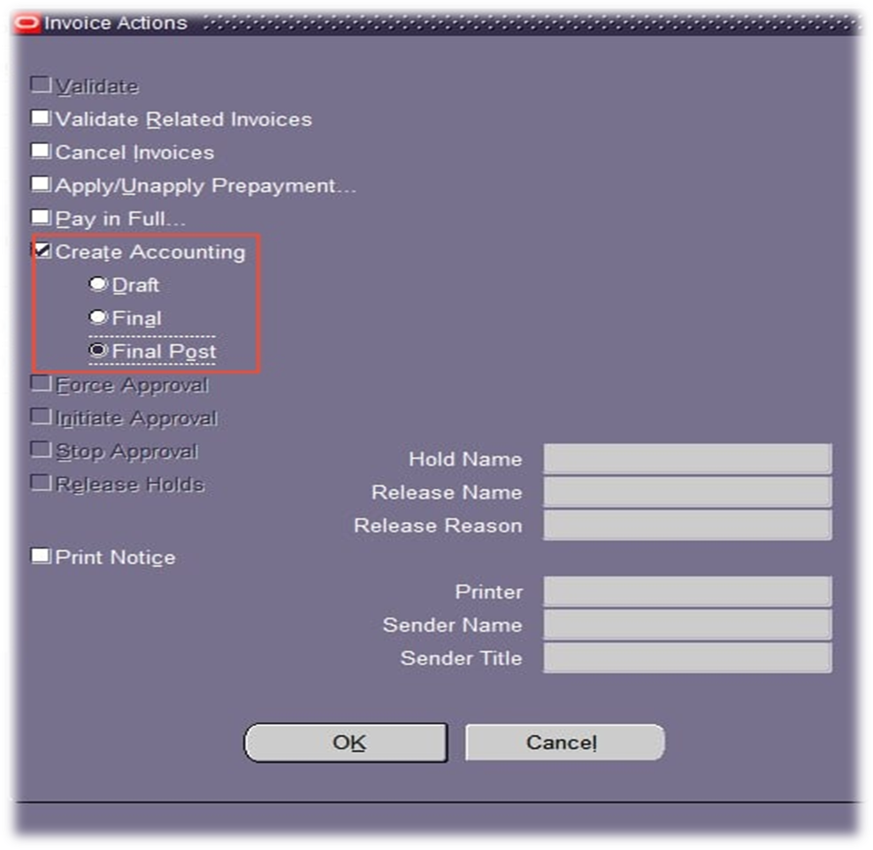
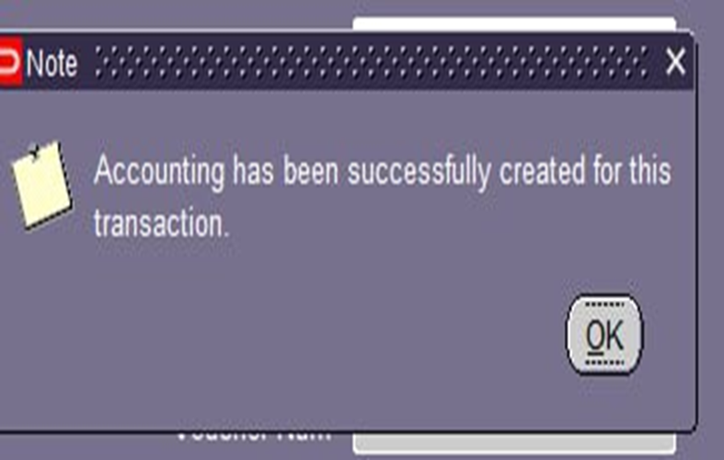
4- Validation and posting :-
*The system verifies that the invoice terms and conditions comply with the supplier's contract
and the company's policies and applies the relevant accounting rules to the invoice, such as
accrual or cash basis accounting.

Slide 16
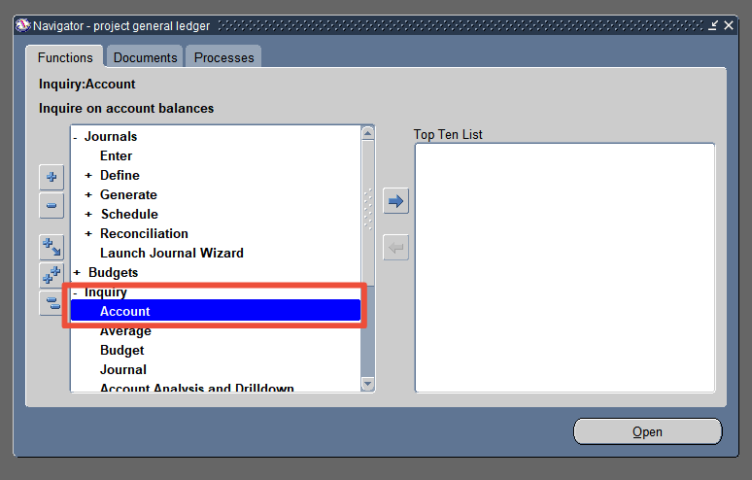
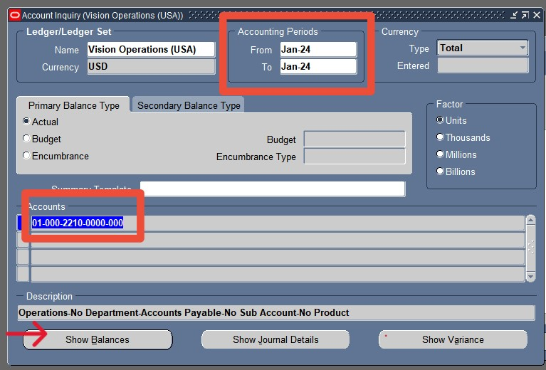
1.From navigation::- * Inquiry >Account
2. Choose the period you want to Inquiry for it
3. click the "Show Balances"
Fourth :- supplier inquiry.

Slide 17
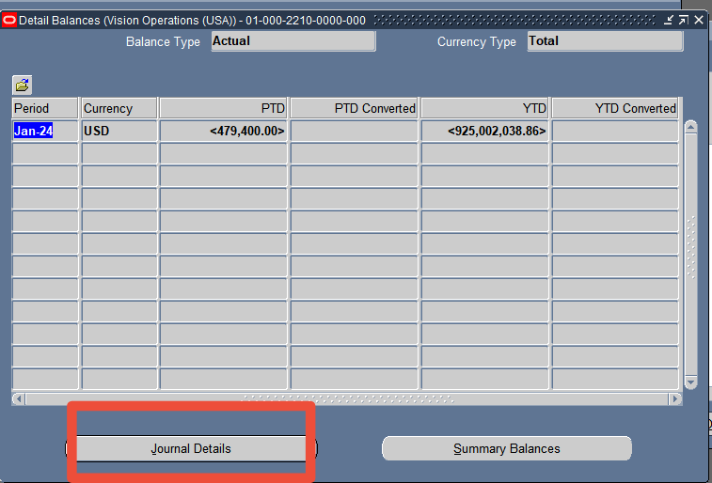
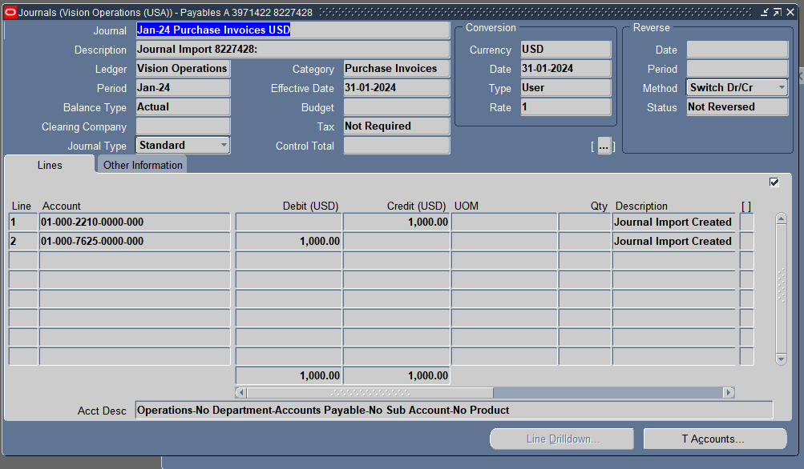
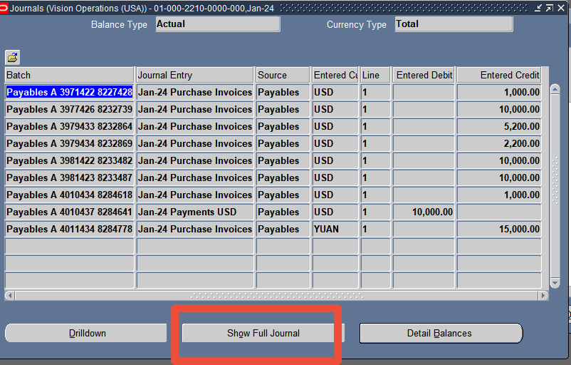
4.choose Journal Details:-
to see the individual journal entries that make up the balance.
5.Click Show Full Journal:-
To see all information related to the entry and transaction.

Slide 18
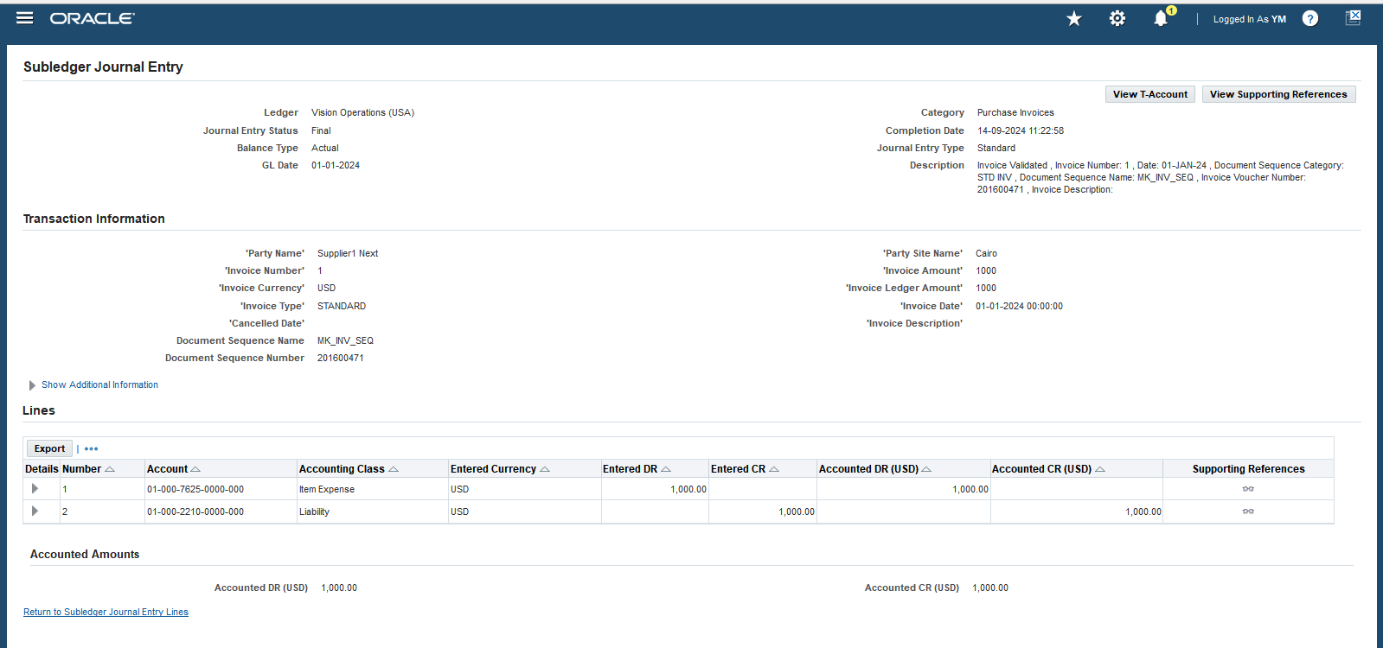
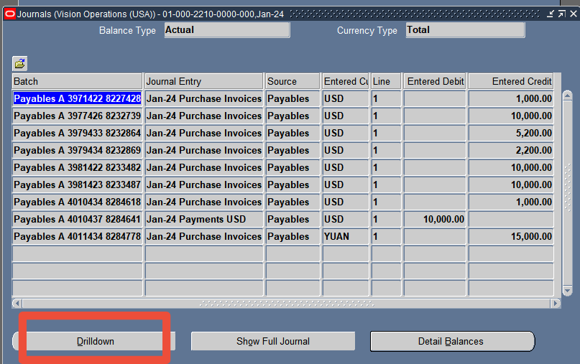
6- *Drill-down :-
* explore further details about these journal entries .

Slide 19
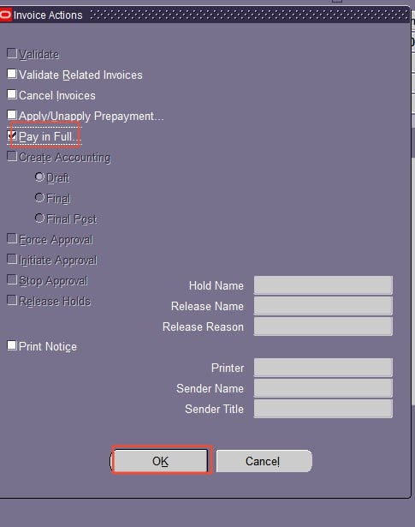
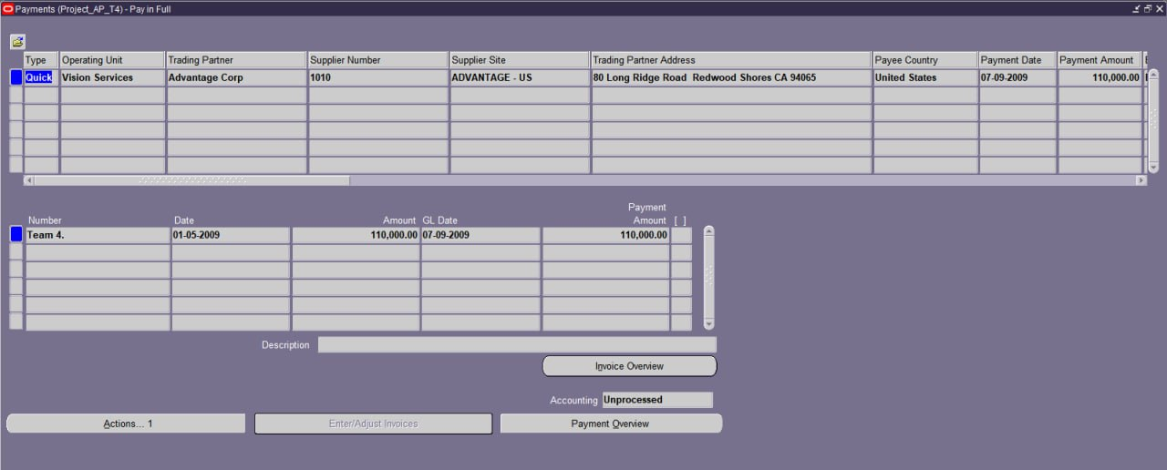
Stage two :- Payment processing and cash management
.
1- Making a payment document
* Enter the necessary information, such as payment date, payment terms, and
payment reference and any additional payment details, such as bank account
information or credit card number.
A- Process supplier payment

Slide 20
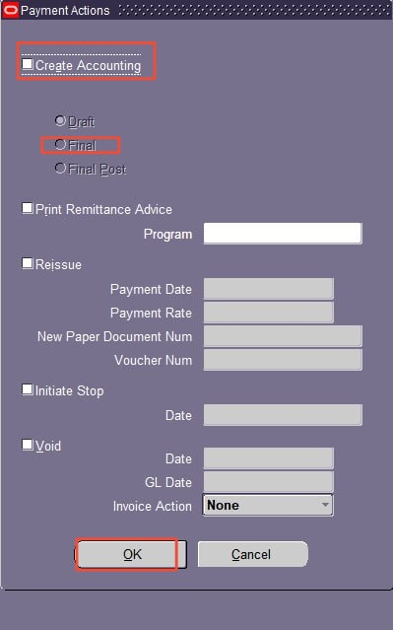
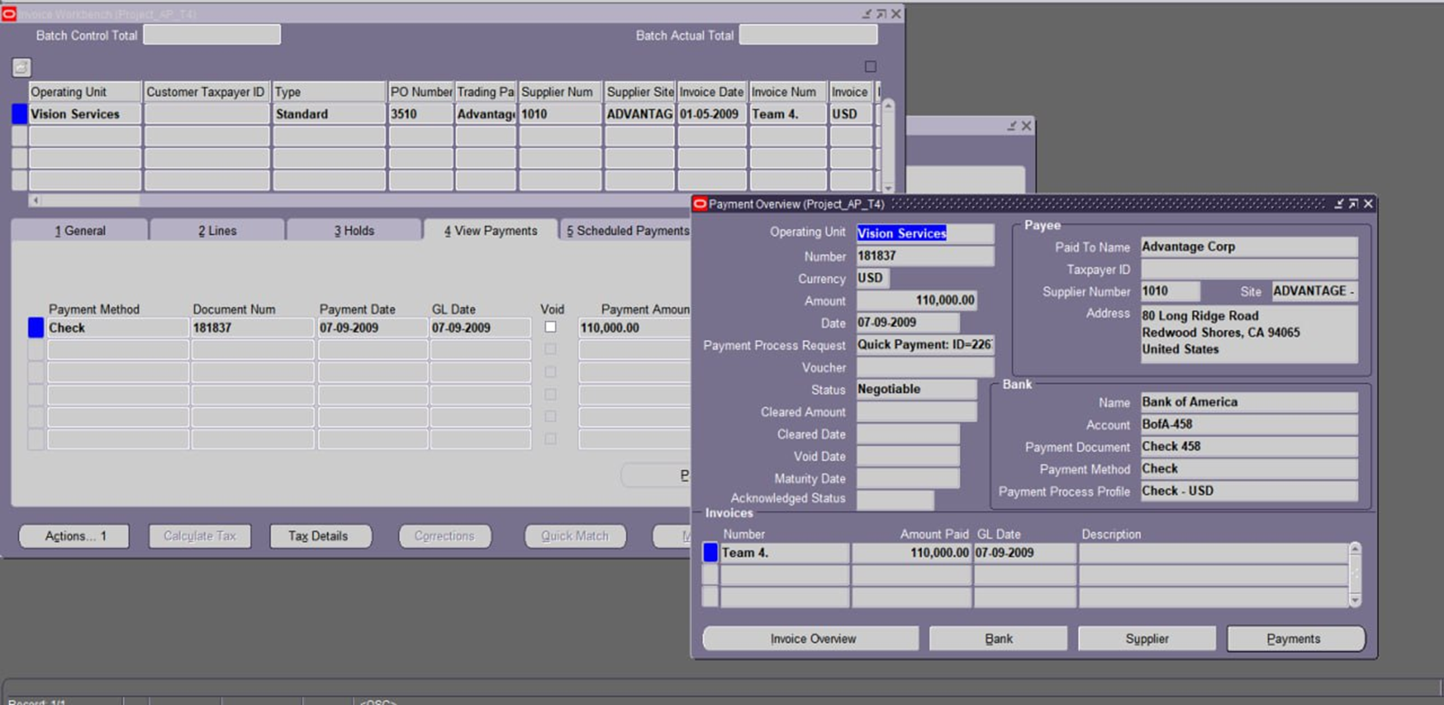

2- Posting the payment and payment overview :-
* The payment will be posting to the general ledger, creating corresponding
journal

Slide 21
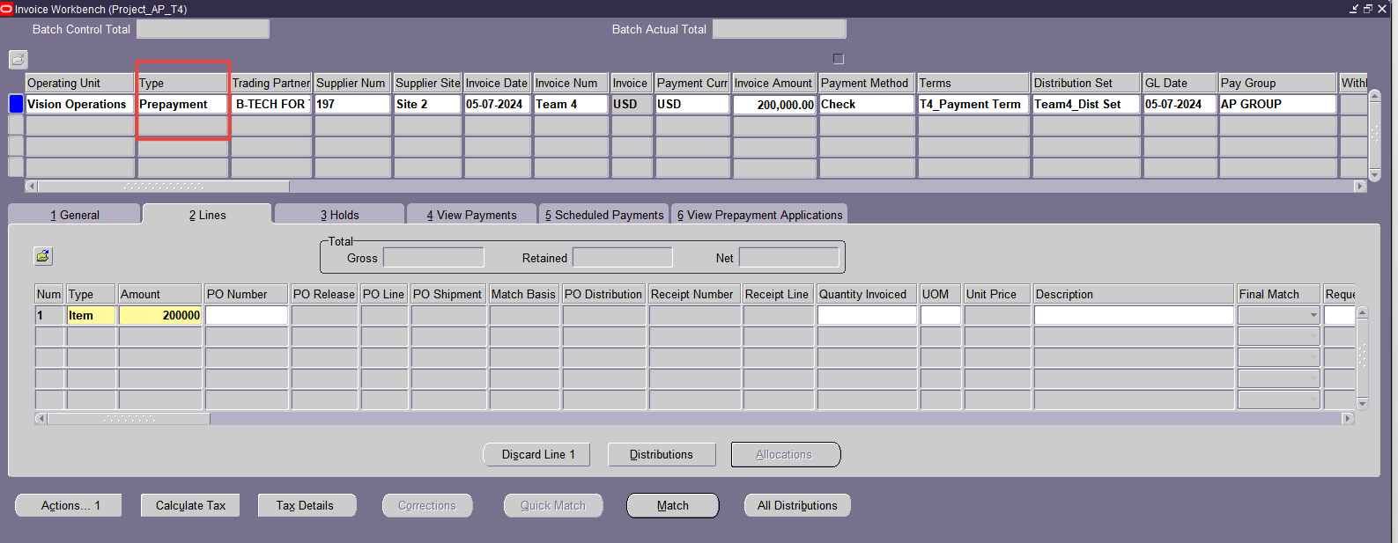
1. Create Prepayment or Advance:-
* Navigate: Go to payables>invoices>entry >invoice
* Enter prepayment Details:
B- Handle prepayments and advances

Slide 22
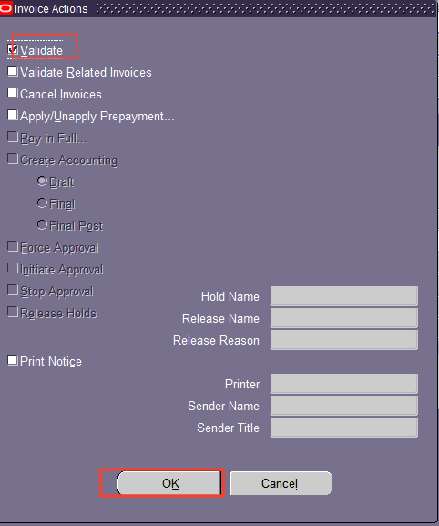
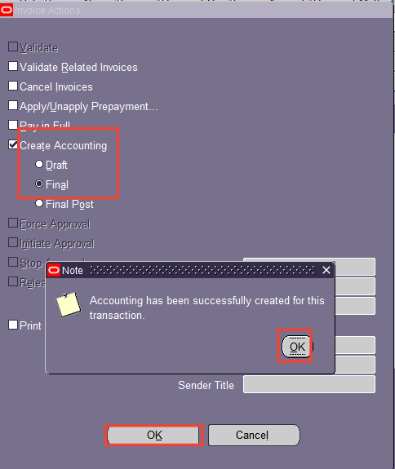
2-Validation and posting :
*checking that all the details entered for the prepayment are correct, such as the amount, vendor, and payment terms and Once validated, the prepayment is recorded in the system's general ledger.

Slide 23

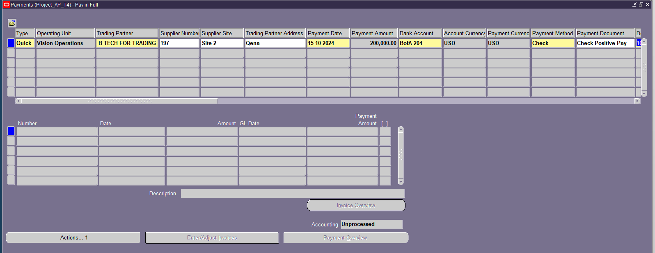
3- Select Payment Method and Bank and write payment details :-

Slide 24
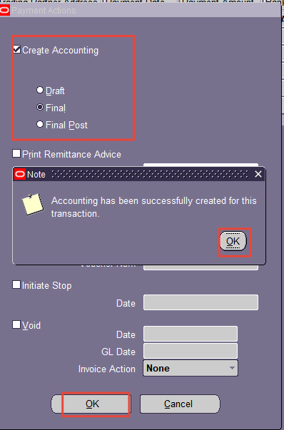
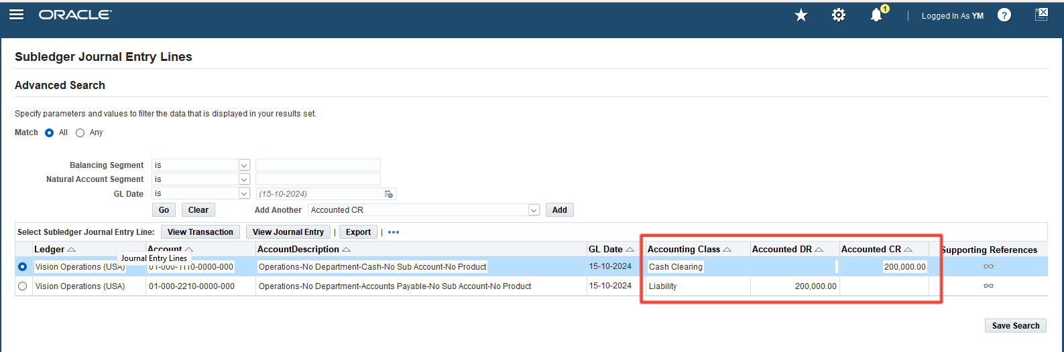
4-Posting the payment:-
* The payment will be posting to the general ledger, creating corresponding
journal

Slide 25
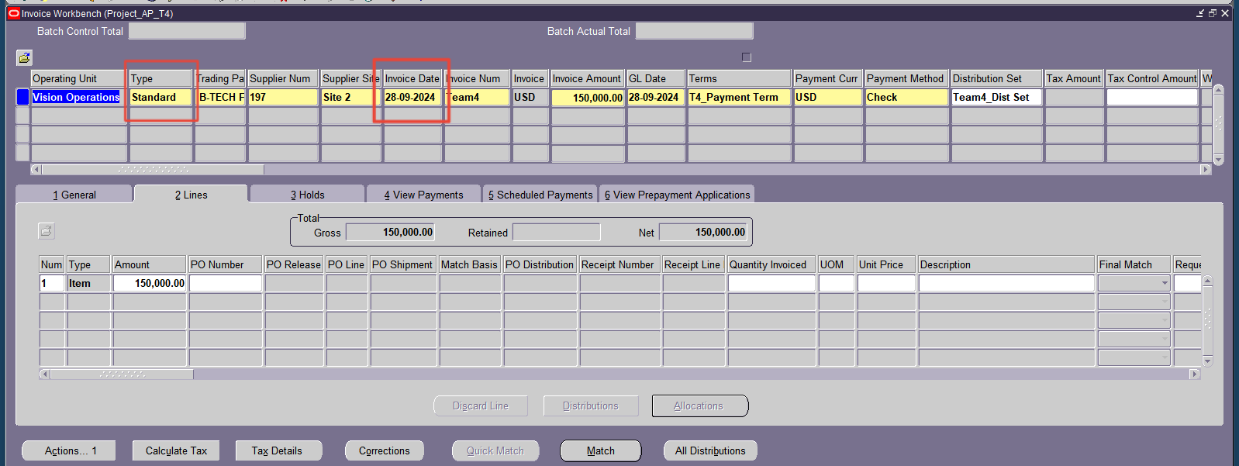
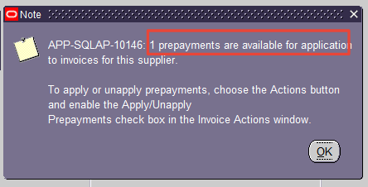
5-The Applying of the prepayment :-
* The prepayment is applied to reduce the amount due on the standard invoice, so when we create an
invoice the option prepayment will appear.

Slide 26
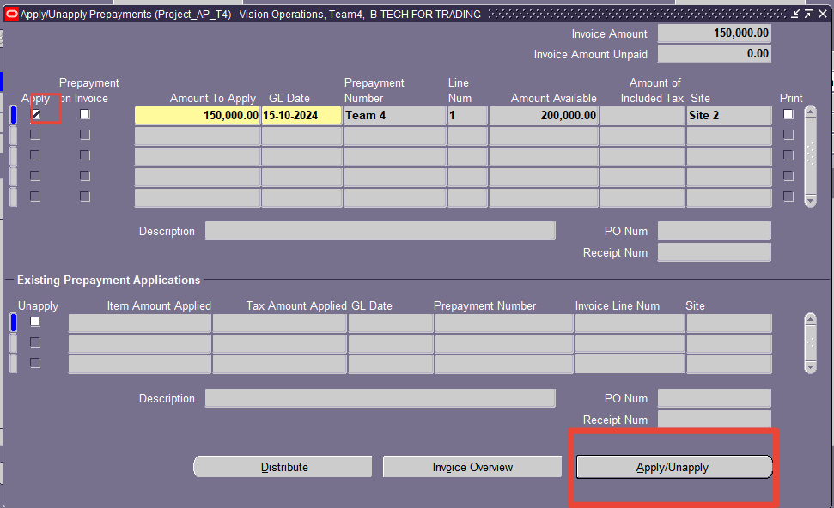
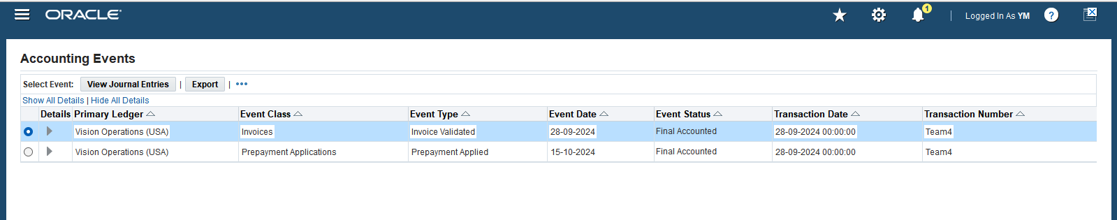
*Then we will validate and apply the prepayment .

Slide 27
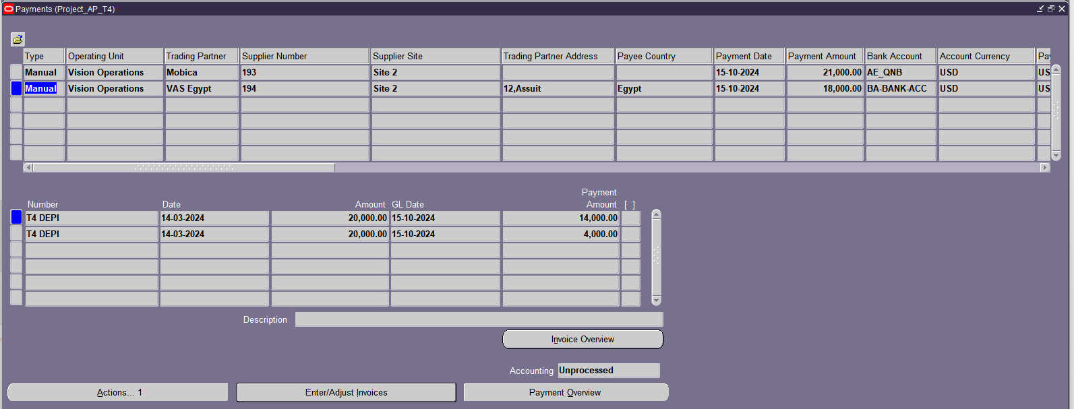
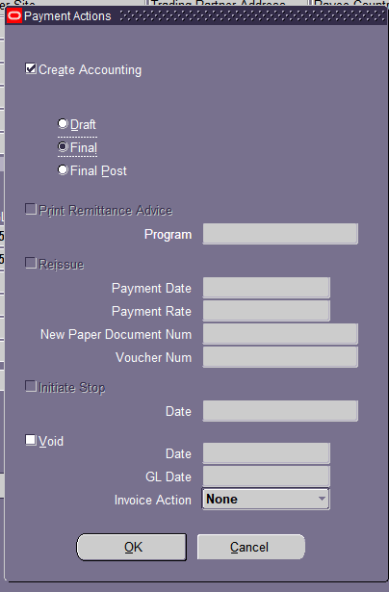
Identify the Payments.
2. Create a Payment Batch.
3. Add Payments to the Batch.
C- Payment Batches:-

Slide 28
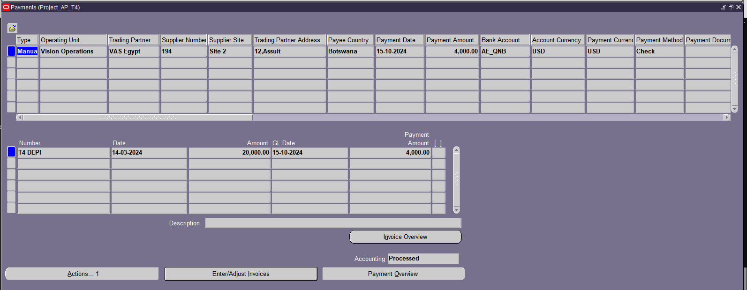
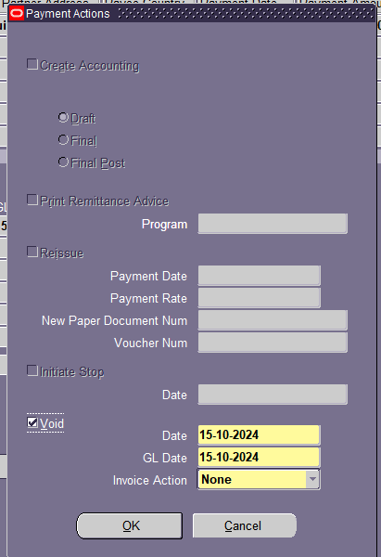
C- void payments and refunds :-
A. Void
1- Create a Voiding Entry: * Select the payment and choose the "Void" option.

Slide 29
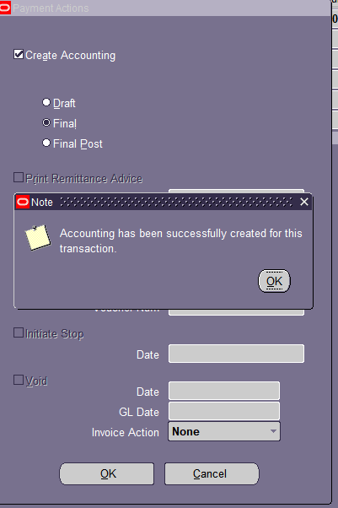
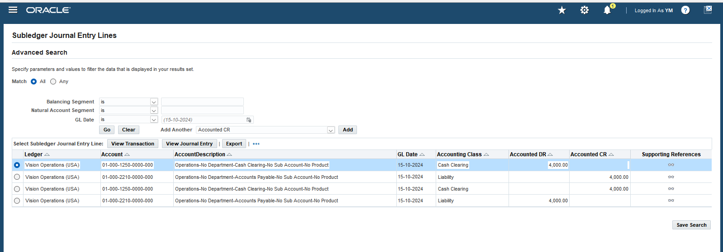
2- . Post the Voiding Entry:
* Post the voiding entry to record the transaction in the general ledger

Slide 30
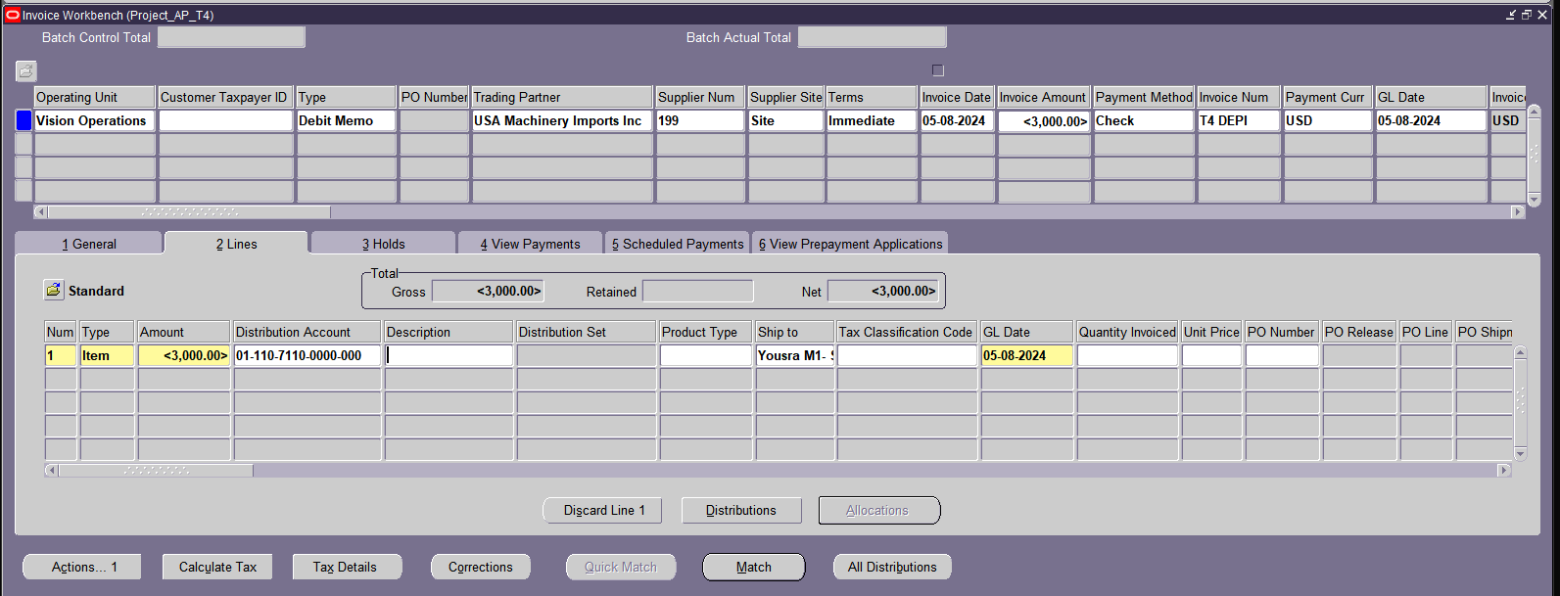
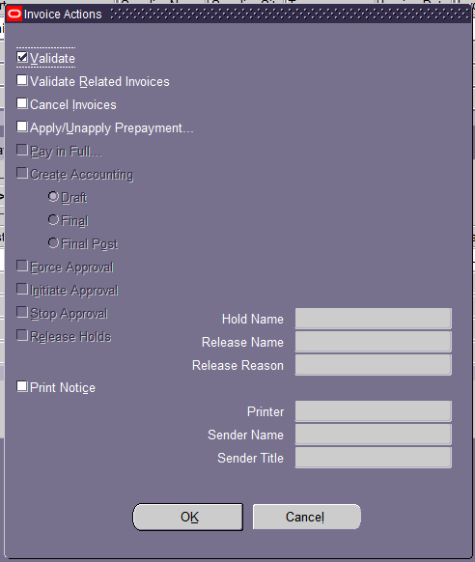
B. payment Refunds :-
1- find a specific payment for the refund .
2- Validate it .

Slide 31
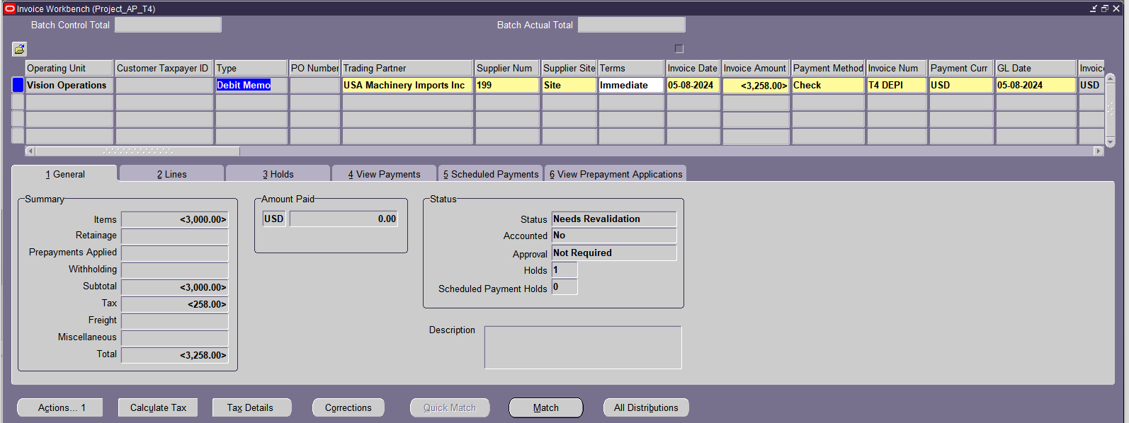
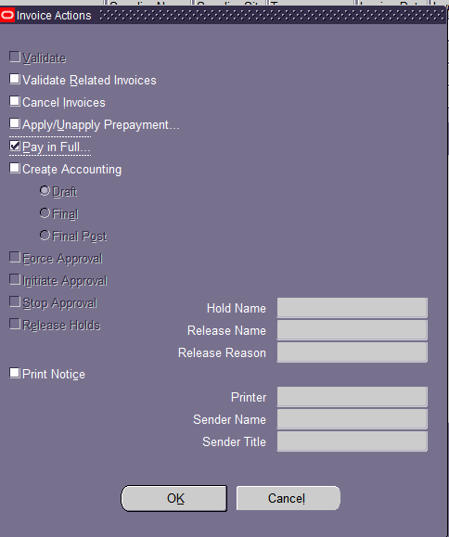

3- Create a debit memo and validate it .
4- Pay the refund .

Slide 32

Stage Three :- Period -End closing and Reporting
-Payables Payment Register:Provides detailed information about payments.
* Search for Report: Use the search function to find the "Payment Register" report.
* Run Report: Once you've found the report, click on it to open it and click "Run.".
A- payment Register Report:-

Slide 33


* View the report :-

Slide 34




Slide 35


B- AP Period-End Close

Slide 36
After the project
1. Reduced Invoice Processing Time
2. Decreased Accounting Errors
3. Improved Cash Flow
4. Enhanced Supplier Management
5. Reduced Operational Costs
* Measurable Outcome: Decrease in invoice processing time by 30% compared to manual processes.
* Measurement: Compare average time taken to input invoices from receipt to system entry before and after implementation.
* Benefit: Accelerates the financial cycle, improves cash flow, and increases efficiency.
*Measurable Outcome: Reduction in accounting errors by 50% using the automated system
*Measurement: Compare the number of recorded accounting errors, such as mismatched invoices or incorrect amounts, before and after implementation.
*Benefit :Reduces time spent on review and auditing, increasing the accuracy of financial records.
*Measurable Outcome: Reduction in overdue invoices by 40% through improved management of accounts payable.
*Measurement:
Measure the percentage of invoices paid on time before and after the project, tracking the payment cycle.
*Benefit: Improves supplier relationships and increases confidence in the company's cash flow.
*Measurable Outcome: Increase in the number of qualified and classified suppliers in the system by 25%.
*Measurement: Calculate the number of new suppliers classified and entered into the system after implementation, as well as the creation of accurate classification reports for each supplier.
* Benefit: Improves the company's relationships with suppliers and increases flexibility in obtaining the best offers and services.
* Measurable Outcome: Reduction in operational costs related to accounts payable management by 20%.
*Measurement: Calculate the costs associated with human resources and time dedicated to accounts payable management before and after using the system.
*Benefit: Reduces operational costs and increases the company's financial return.

Slide 37
6. Increased Transparency of Financial Operations
7. Reduced Financial Close Cycle
8. Improved Accuracy of Cash Flow Forecasts
9. Enhanced Internal Control
10. Improved Responsiveness of the Finance Team
* Measurable Outcome: Increase in the percentage of financial reports generated accurately and automatically by 35%.
*Measurement: Measure the number of financial reports generated automatically by the system compared to the number that required manual intervention.
*Benefit: Improves the ability to make quick and informed financial decisions.
*Measurable Outcome: Reduction in the time taken to close the financial period by 25%.
* Measurement: Compare the time taken to close accounts payable and accounting settlements between financial periods before and after implementing the system. * Benefit: Improves the efficiency of financial operations and accelerates the preparation of monthly or annual financial reports
*Measurable Outcome: Improvement in the accuracy of cash flow forecasts by 30% through the use of real-time accurate payment reports.
*Measurement: Compare the accuracy of future cash flow forecasts before and after using the system, based on payment commitments and outstanding invoices.
* Benefit: Enables management to make better strategic decisions based on more accurate cash flows.
* Measurable Outcome: Improvement in internal control levels by 40% through automated tracking of payments and invoices.
*Measurement: Measure the number of financial transactions tracked and reviewed internally through the system compared to those done manually.
* Benefit: Strengthens financial governance and reduces the risk of financial fraud.
* Measurable Outcome: Improvement in the finance team's response to invoice and payment reports by 20%.
*Measurement: Measure the time taken to prepare financial reports or process invoices between different finance teams before and after implementing the project.
* Benefit: Increases the speed of financial decision-making and improves the efficiency of accounts payable management.

Slide 38
Summary of Potential Achievements:-
By implementing an Oracle EBS R12 accounts payable project, you can achieve numerous measurable outcomes, such as reducing financial errors, improving cash flow, reducing operational costs, and increasing the accuracy of financial reports. These achievements will help improve the overall financial performance of the company and will be a valuable addition to your professional experience.

Slide 39
THANK YOU

